Slide 1
Financial Aid and Making
$mart Money Choices
Presented by:
Ventura College Financial Aid Office

Slide 2
Financial Aid Reminders

Slide 3
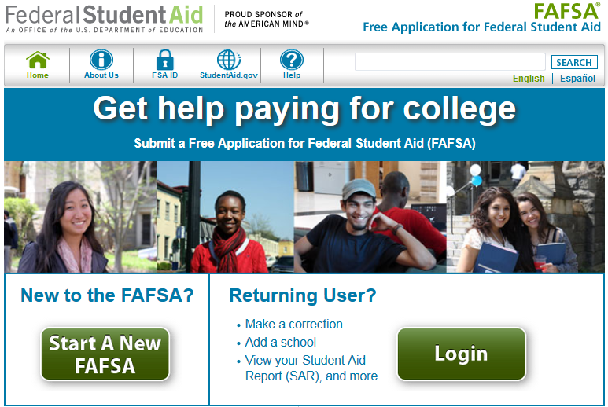
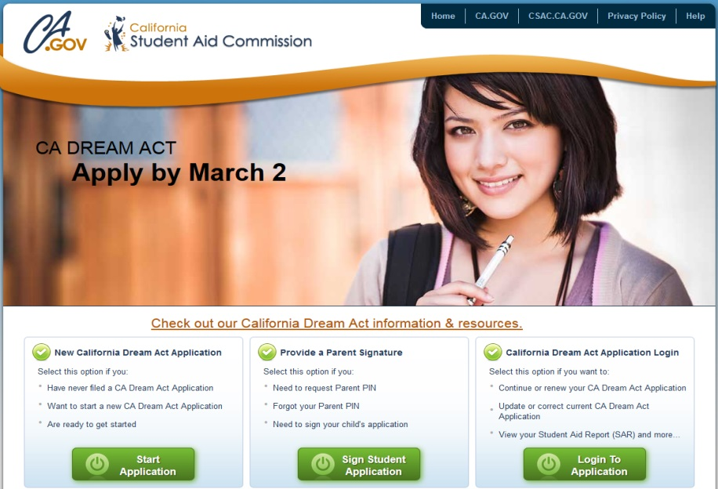
APPLY TODAY!
IT’S NOT TOO LATE TO APPLY FOR FINANCIAL AID
The 2017-2018 FAFSA and Dream Act Applications are available online at www.fafsa.gov OR www.caldreamact.org
*2018-2019 applications will open October 1, 2017

Slide 4
Satisfactory Academic Progress (SAP)

Slide 5
WHAT IS SAP?
The Ventura County Community College District (VCCCD) Financial Aid Offices establish standards of academic progress in accordance with federal regulations.
To be eligible for aid, students must meet or exceed these standards:
  Minimum cumulative GPA of 2.00 in all coursework attempted.
  Minimum course completion rate of 70% of ALL coursework attempted.
  Students must complete their educational goal within 150% of the length of their program of study. ALL coursework appearing on their VCCCD transcript will count towards Maximum Time Frame.

Slide 6
WHAT ARE THESE STANDARDS? continued
Passing Grades (Completed coursework)
  A, B, C, D, P, CR (Credit) or CRE (Credit by exam).
Non-passing Grades
  F, I (Incomplete), IP (In Progress), W (Withdrawal), MW (Military Withdrawal), NS (No Credit), NP (No Pass) and RD (Record Delayed).
ALL grades are considered attempted units.

Slide 7
WHAT HAPPENS WITH SAP AT THE END OF FALL 2017?
SAP will be evaluated at the end of each semester once all instructors have submitted final grades.
The evaluation will consist of all coursework attempted through the end of the current semester.
Students who fail to meet academic progress (70% and/or cumulative GPA of 2.00) will be placed on Financial Aid Warning.
Students who are currently on Financial Aid Warning and fail to meet academic progress by the end of spring 2017 will be placed on Financial Aid Suspension.

Slide 8
Board of Governors (BOG) Fee Waiver

Slide 9
BOG FEE WAIVER
SAP REQUIREMENTS
Students with two consecutive primary semesters of not meeting academic and/or progress standards may lose their BOGW eligibility
Academic and progress standards include:
  Academic: Sustain a cumulative GPA of 2.00 or higher
  Progress: Complete more than 50% of your coursework

Slide 10

WHAT SHOULD I DO BEFORE DROPPING A CLASS?
Reach out to your instructor.
Visit the Tutoring Center.
Meet with an Academic Counselor.
Notify the Financial Aid Office.

Slide 11
Financial Aid Limits

Slide 12
PELL LIFETIME ELIGIBILITY USED (PELL LEU)
The amount of Federal Pell Grant funds you may receive over your lifetime.
You are limited to six full-time years (12 semesters/600%) of Pell Grant eligibility.
Check your lifetime eligibility at www.nslds.ed.gov

Slide 13
DIRECT SUBSIDIZED LOAN ELIGIBILITY
Students borrowing a loan on or after July 1, 2013 will be limited on the maximum period of time (measured in academic years) they can receive Direct Subsidized loans.
This period is based on the Maximum Time Frame of your declared program of study.
After you receive Direct Subsidized Loans for your maximum eligibility period, you are no longer eligible to receive additional subsidized loans.

Slide 14

$mart Money Choices
You Can Make Today

Slide 15


APPLY FOR FREE MONEY-- SCHOLARSHIPS!
Ventura College Foundation
Outside Scholarships:
  www.fastweb.com
  www.scholarships.com
  https://studentaid.ed.gov
  www.hispanicfund.org
  https://bigfuture.collegeboard.org/scholarship-search
  and MORE!

Slide 16

BEWARE OF
SCHOLARSHIP SCAMS...
If any of these apply…
  They guarantee they have information you can’t get anywhere else
  They charge a fee to apply
  They offer you money when you haven’t even applied
  They don’t have any legitimate contact information
… IT’S PROBABLY A SCAM!

Slide 17


USE LOANS AS A LAST RESORT
Remember, loans must be REPAID!
  Apply for as many scholarships and grants as possible
  Keep a part-time job if you can without impacting your school work to help with costs
If you must borrow loans…
  Borrow as little as possible and only for school expenses
  Borrow only what you can realistically repay later
    Repayment Estimator: https://studentloans.gov
      Every choice you make now will
      affect your financial future

Slide 18

BUDGET
What is a budget?
  A financial plan; an estimate of your likely income and expenses for a given period (e.g. a month)
Why is it important to budget?
  Take control of your money; don’t let your money control you.
  Don’t find yourself with empty pockets in the middle of the semester
  Avoid or minimize debt
  Obtain your goals, including saving! Achieving them requires planning and action.
He who fails to plan, plans to fail - Proverb

Slide 19
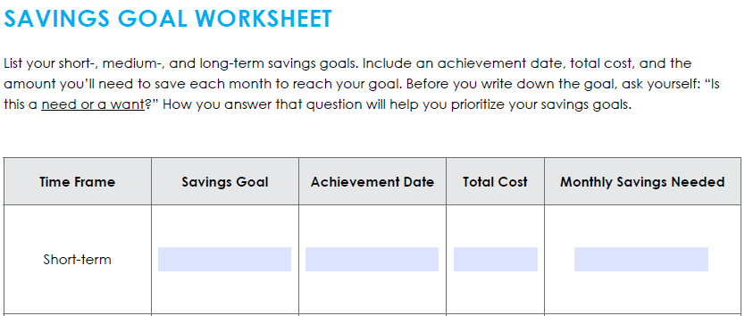
SET SMART GOALS
SPECIFIC: Be specific enough to suggest action
MEASURABLE: You need to know when you achieved your goal or how close you are
ATTAINABLE: The steps toward reaching your goal need to be reasonable and possible
RELEVANT: Are you working towards a goal that fits your need?
TIME-RELATED: Set a definite target date

Slide 20
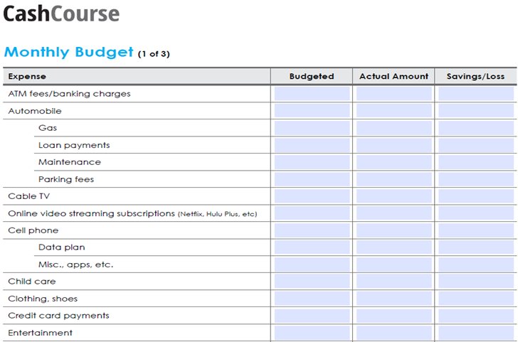

SAMPLE BUDGET
The “secret” every millionaire knows:
Live within your income!

Slide 21
BUDGETING STEP-BY-STEP
List your estimated expenses for the month
  Fixed: rent, auto insurance, utilities, etc.
  Variable: food, clothing, gas, entertainment, etc.
List your estimated income for the month
  If you receive financial aid, divide the disbursed amount by the number of months in the semester
Adjust your budget based on your goals and realities
  Save for an emergency, a car, a vacation.. What’s your goal?
Track your spending
  Where are you over-spending? Where can you cut costs?
Adjust your budget as needed
Don’t forget to incorporate savings and goals into your budget.
If your expenses are > than your income, you must either reduce your expenses or increase your income.

Slide 22

DETERMINE NEEDS VS. WANTS
NEEDS
Shelter
Food/Water
Clothing/Shoes
Transportation
Utilities
Personal care expenses
Books and supplies
Basic phone and internet
WANTS
Latest smart phone, gadget, etc.
New expensive car
Daily costly coffee drink
Apps, games, etc.
Cable TV, highest-speed internet
All new books and supplies
New brand-name clothes/shoes
Costly entertainment
Spend primarily on NEEDS and look for ways to spend less and even save.
Always remember your GOALS: Ask yourself before spending, “What could I better use this money for? Do I absolutely need this now?”
Don’t live like a professional when you are a student
so you don’t live like a student when you are a professional.

Slide 23

MORE MONEY-SAVING
STRATEGIES
Use your student ID for student discounts
Buy used books or borrow if possible; check out books at the library; take advantage of the Lending Library
Take advantage of free or low-cost entertainment
Cut out costly habits
Make a shopping list of needs and stick to it. Clip coupons.
When possible, carpool or avoid driving excessively to save on gas and parking
Eat out less often
Every little bit helps!

Slide 24
BUILD YOUR CREDIT
It is important to build good credit NOW so you can take out a loan for big purchases like a car or a house later. Many employers and landlords also check your credit, so building good credit now can help you land your dream job or home.
  Pay bills on time and repay loans as promised
  Pay off any credit balances in full each month
  Do not bounce checks or overdraw your account
  Contact creditor immediately if you are struggling to make payments
  Monitor your credit reports regularly to ensure your credit is not being used and ruined due to identity theft
    www.annualcreditreport.com
    www.bankrate.com

Slide 25
TIPS TO
PROTECT YOUR IDENTITY
Monitor your credit reports, bank accounts, even your federal financial aid history on NSLDS
Do not share your user IDs, passwords, PIN #s and any other personal information with others
Do not disclose sensitive identity information in public
Opt out of pre-approved loan and credit card offers
Shred anything you don’t need with sensitive information
Do not carry your Social Security card in your wallet
Avoid making purchases with cards
Make sure a site is secure before entering private data
Do not respond to suspicious emails or phone calls

Slide 26

HELPFUL RESOURCES
CashCourse- FREE resources to help you make informed financial choices.
Financial Aid TV- Short videos to answer questions about financial aid and money management.
VC Financial Aid Website- Up-to-date information regarding office hours, financial aid regulations, etc.

Slide 27
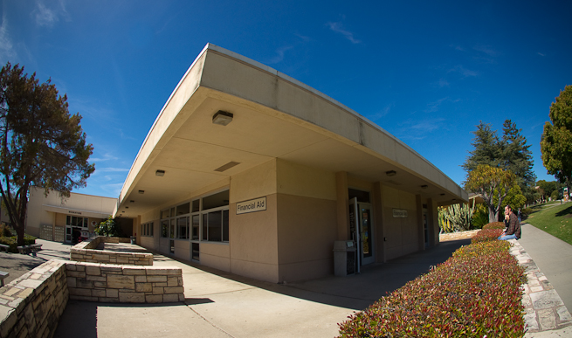
CONTACT FINANCIAL AID
Monday, Wednesday, Thursday 8:30am – 3:30pm
Tuesday 8:30am – 6:30pm
Friday Closed for processing
Bookstore and Campus Services (BCS) building
Telephone: 805.289.6369
Fax: 805.289.6383
Email: vcfinancialaid@vcccd.edu
Like us on Facebook: https://www.facebook.com/vcfao
Follow us on Twitter: @VCFAO

